Slide 1


REGRESSION BASED ANALYSIS OF WORLD HAPPINESS REPORT 2021
INDIAN INSTITUTE OF TECHNOLOGY KANPUR
SHWETANK SINGH (201422)
NISTHA SHAH (201358)
AKASH KUMAR SHARMA (201261)
ASHISH KUMAR (201283)
RAHUL KUMAR SINGH (201378)

Slide 2
Introduction
Objective: To model happiness over various factors like, GDP per capita, Social Support, health, Freedom, Generosity and Perception of Corruption.

Slide 3
About the Data
Response:
Y:Ladder Score
Regressors:
X1:Logged GDP Per Capita
X2:Social Support
X3:Healthy Life Expectancy
X4:Freedom To Make Life Choices
X5:Generosity
X6:Perception Of Corruption

Slide 4
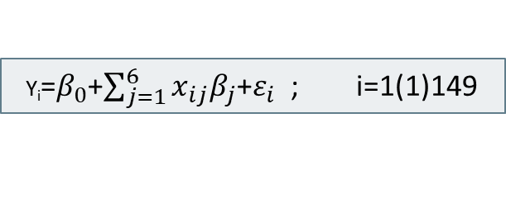
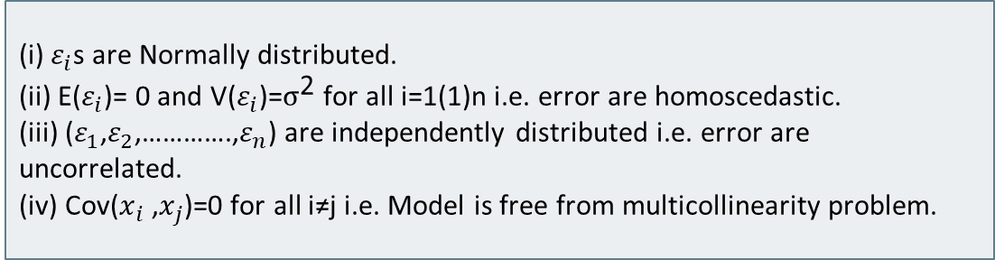
Model & Assumptions
Model:
Y_{i}=$β_{0}$+$\sum_{j=1}^{6}{x_{ij}β_{j}}$+$ε_{i}$ ; i=1(1)149
Assumptions:
(i) $ε_{i}$s are Normally distributed.
(ii) E($ε_{i}$)= 0 and V($ε_{i}$)=$σ^{\text{2}}$ for all i=1(1)n i.e. error are homoscedastic.
(iii) ($ε_{1}$,$ε_{2}$,………….,$ε_{n}$) are independently distributed i.e. error are uncorrelated.
(iv) Cov($x_{i}$ ,$x_{j}$)=0 for all i≠j i.e. Model is free from multicollinearity problem.

Slide 5
Parameter Estimate and Summary
.
Significance Codes: ‘***’ 0.001 ‘**’0.01 ‘*’0.05 ‘.’0.1 ‘ ’1
Coefficients Estimates Std. Error t- value p-value Significance
Intercept 2.23722 0.63049 -3.548 0.000526 ***
x1 0.27953 0.08684 3.219 0.001595 **
x2 2.47621 0.66822 3.706 0.000301 ***
x3 0.03031 0.01333 2.274 0.024494 *
x4 2.01046 0.49480 4.063 7.98e-05 ***
x5 0.36438 0.32121 1.134 0.258541
x6 -0.60509 0.29051 -2.083 0.039058 *

Slide 6
Summary of the Model
Residual standard error: 0.5417 (with 142 df).
Model R-squared: 0.7558
Adjusted R-squared: 0.7455
p-value: < 2.2e-16
F-statistic: 73.27 (on 6 & 142 df).
74.55% of the total variability present in the model is explained by our regression model.
Observed F-statistic(73.27) > tabulated F-value(2.1629), So, we reject H₀ & interpret that the regression model is significant.

Slide 7
Checking Skewness in the Data
We have 6 regressors. To check the skewness we draw the boxplot and density curve for each independent variables. Boxplot and Density curves of each independent variables are drawn below:

Slide 8
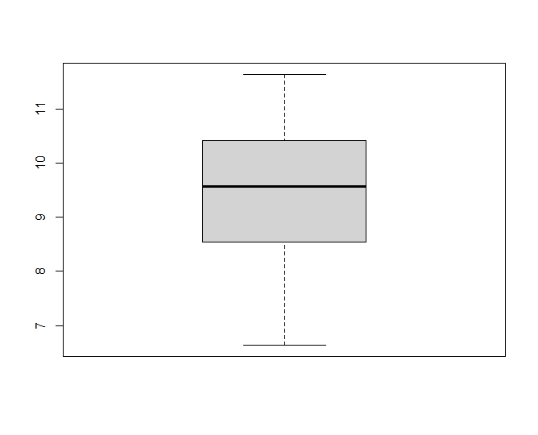
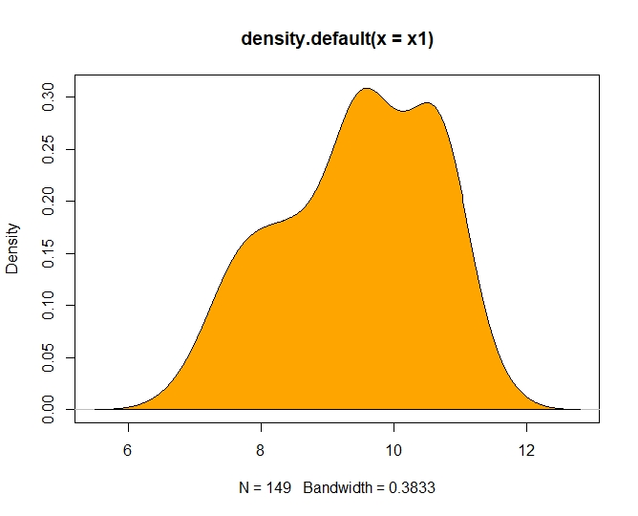
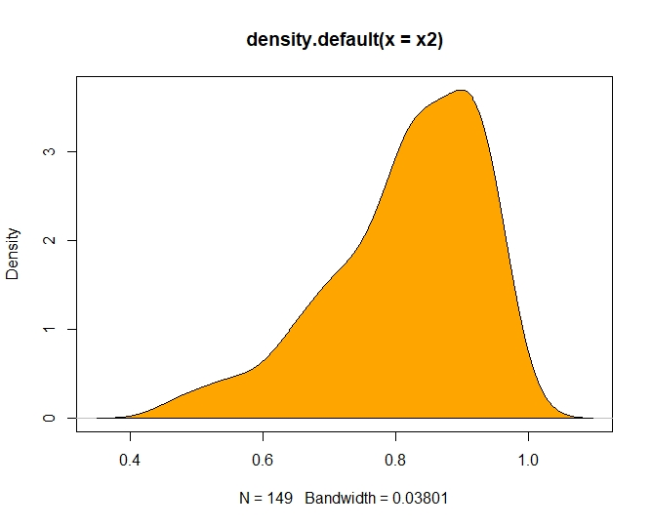
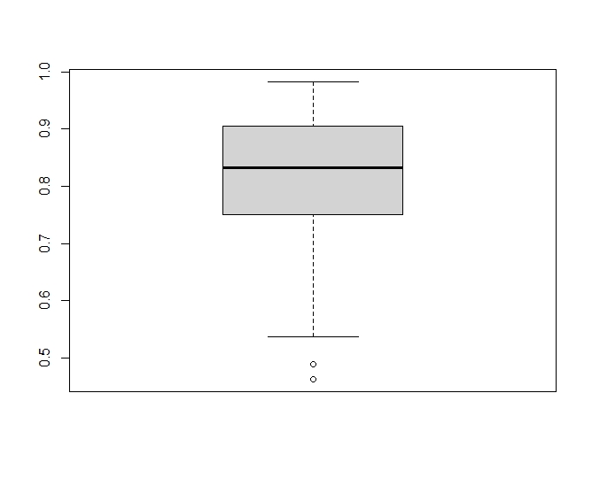
X1
X2

Slide 9

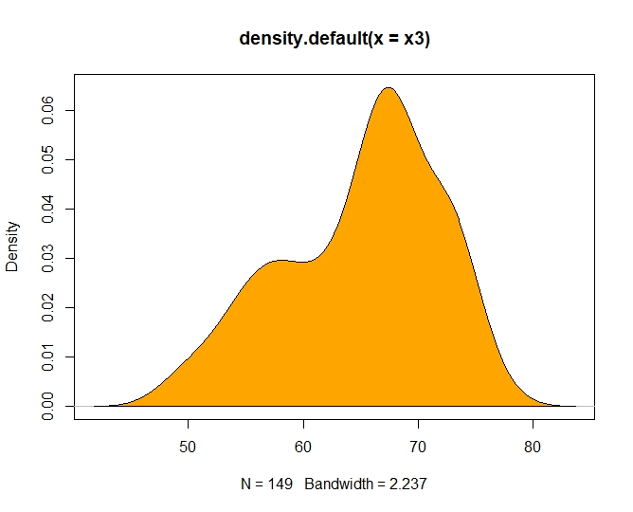
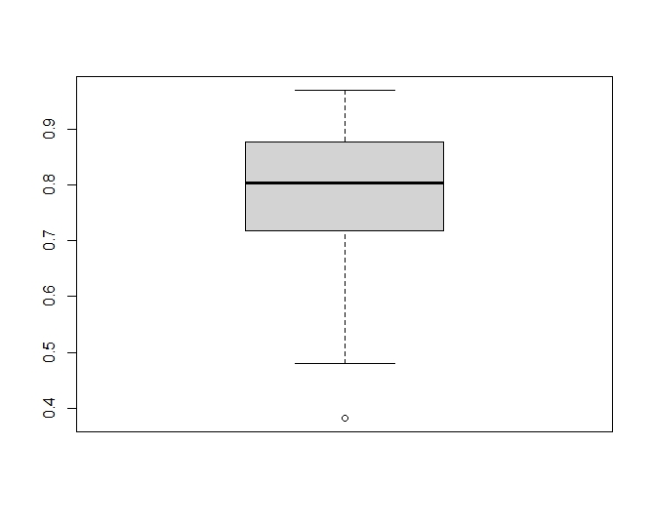
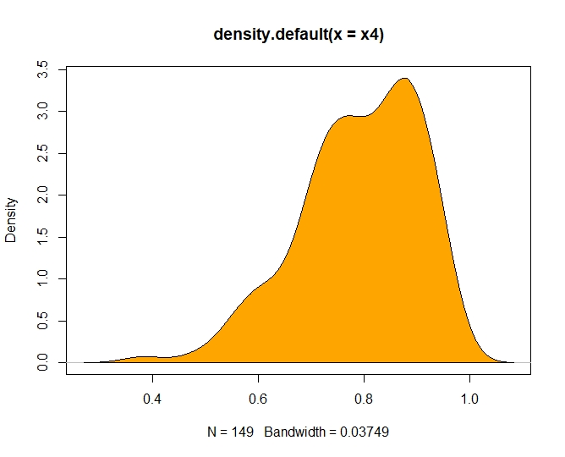
X3
X4

Slide 10
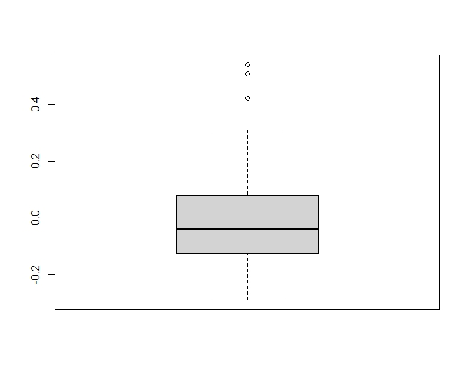
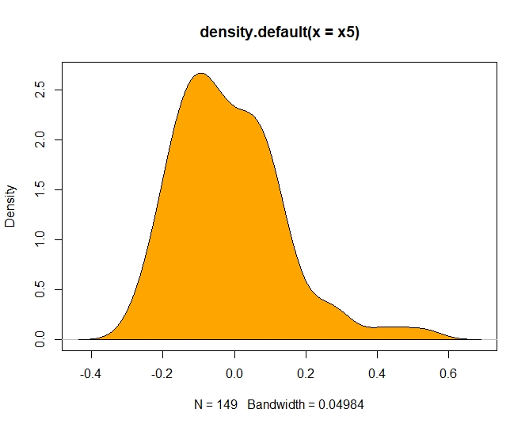
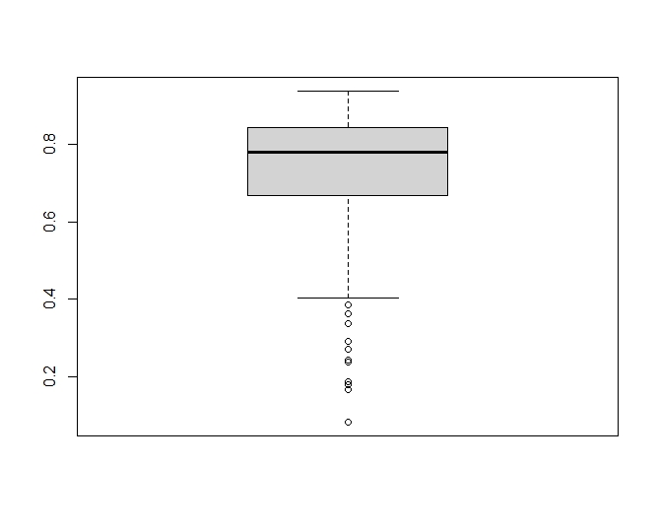
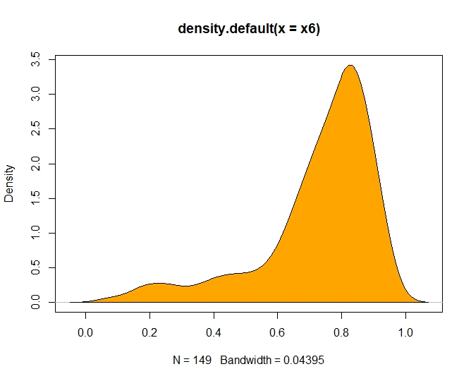
X5
X6

Slide 11
Conclusion About Skewness
Skewness of x1 , x2 , x3 , x4, x5 and x6 are respectively -0.3449691, -0.9190126, -0.511535, -0.7396695, 0.9897123, -1.545846.
We found that the none of the regressors are highly skewed. So we haven’t used any transformation.

Slide 12
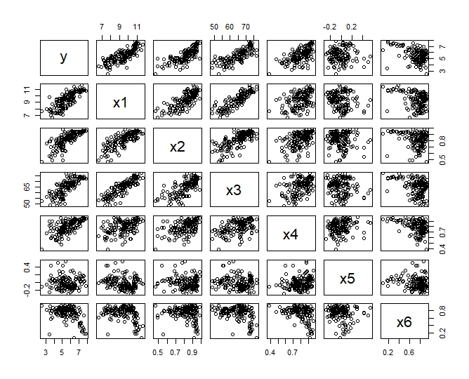
Observation From Scatter Plot Matrix

Slide 13
Some Observations
There is linear relationship between ‘Logged GDP per capita’ (X1) & ‘Social support’ (X2).
There is linear relationship between ‘Logged GDP per capita’ (X1) & ‘Healthy life expectancies’ (X3).

Slide 14
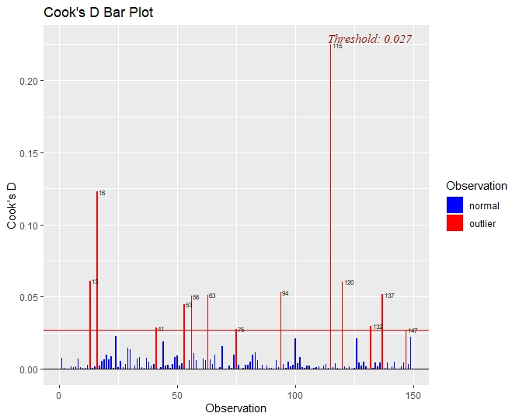
Checking for Outliers
Cook’s distance, Di, is used in Regression Analysis to find the influential outliers in a set of predictor variables In other words, it’s a way to identify points that negatively affect your regression model.
Cooks’s D Bar Plot

Slide 15
Checking Normality Assumption

Slide 16
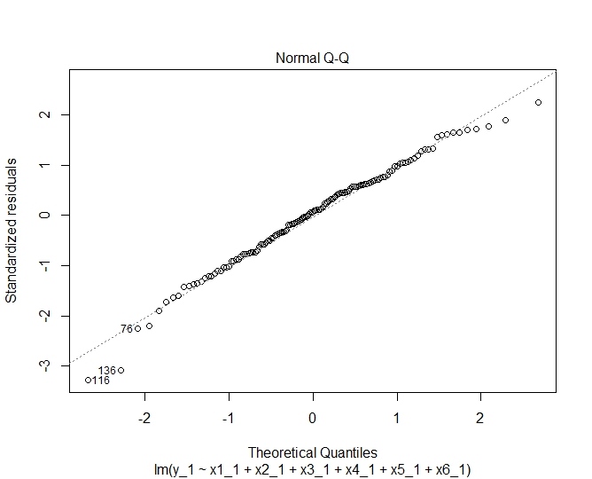
Q-Q Plot
Since the data points are approximately lying on the 45˚ diagonal line we can assume normality for Y and ε.

Slide 17
Shapiro-Wilk test
H₀: Errors are normally distributed
Against
H₁: H₀ is not true
Test statistic W= 0.98465
p-value= 0.1315>0.05(α)
Since, the null hypothesis (H₀) is accepted at 5% level of significance, we can confirm that Y and hence the errors follow a normal distribution.

Slide 18
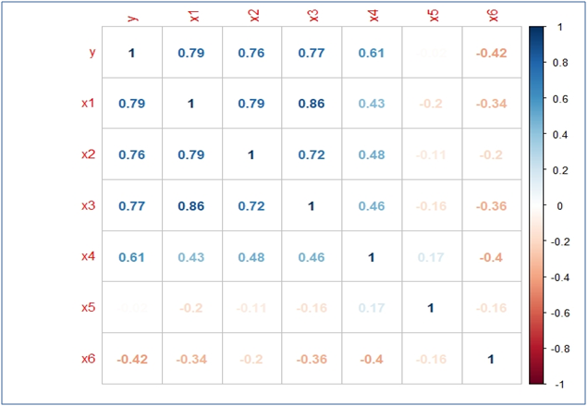
Multicollinearity
This matrix tells that there are regressors that are linearly related to each other. Hence gives an indication that there is multicollinearity present in some group of variables.
Correlation Matrix

Slide 19
Variance Inflation Factor(VIF) Method
This method is used to identify regressors that are involved in multicollinearity.
Some Observation:
Variable | VIF
X1 | 5.104890
X2 | 2.972200
X3 | 4.099348
X4 | 1.585807
X5 | 1.180982
X6 | 1.367122
VIF value greater than 5 indicate multicollinearity and large value of multicollinearity leads to poor estimates of regression coefficient.
Here we saw that, VIF corresponding to regressors ‘logged GDP’ (X1 ) is greater than 5 which indicates that this variable is involved in multicollinearity.

Slide 20
Methods for reducing Multicollinearity
Ridge Regression Model
Principal Component Regression(PCR)
Why we use Ridge regression and principal Component regression model?
Since we have only six regressors in our data and we consider all of them important to predict ladder score. So instead of eliminating them we will see effect of the each regressor on the response. For this, we’ve used Ridge regression and principal component regression(PCR) to reduce multicollinearity. Then we will compare the efficiency of these two methods.

Slide 21
Ridge Regression
Ridge function: R(β) = (Y-Xβ)’(Y-Xβ) + λβ’β
How to choose value of λ?
1) Ridge trace plot
2) Iterative procedure(by Hoerl & Kennard)

Slide 22
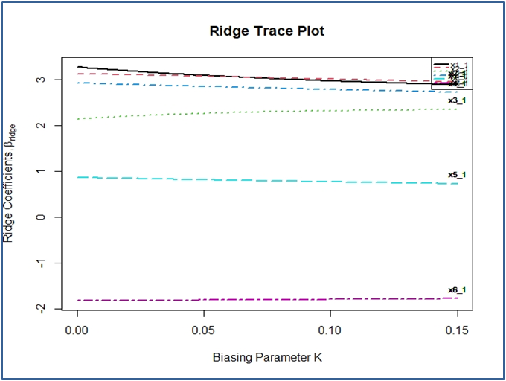
Ridge trace plot
From the trace plot we observe that appropriate value of λ should be around 0.03 so that all the estimates of parameters stabilize.

Slide 23
Iterative procedure
The estimate of λ obtained by this method is 0.0297.
AFTER FITTING:
VIFs have decreased significantly. New VIF’s of each regressors are as follows:
The adjusted R-sq is 80.12%
Variable | X1 | X2 | X3 | X4 | X5 | X6
VIF | 3.50804 | 2.57029 | 2.99295 | 1.47156 | 1.09597 | 1.20986

Slide 24
Principal Component Regression
 | PC1 | PC2 | PC3 | PC4 | PC5 | PC6
Standard deviation | 1.790 | 1.1264 | 0.8125 | 0.7129 | 0.48785 | 0.34762
Proportion of Variance | 0.534 | 0.2115 | 0.1100 | 0.0847 | 0.03967 | 0.02014
Cumulative Proportion | 0.534 | 0.7455 | 0.8555 | 0.9402 | 0.97986 | 1.00000
We can explain 94.02% of variation using the first 4 principal components. After that the increase in proportion of variance is not so significant. So, we choose 4 principal components from the 6. Also, it can be seen from the PCR scree plot which plots the cumulative variances corresponding to each principal component

Slide 25
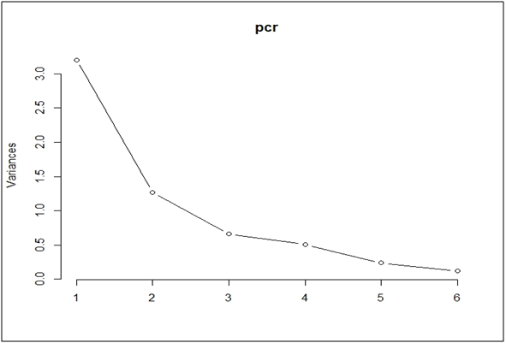
Scree Plot

Slide 26
After Fitting
VIFs of corresponding to each of the 4 principal components become 1.
The adjusted R-sq is 81.82%.

Slide 27
Heteroscedasticity
Now we will check if the data is homoscedastic or heteroscedastic; In regression analysis it is required that the errors are homoscedastic. Errors have mean zero and constant variance and are uncorrelated. So Y should also be homoscedastic in nature.
We will check this through following models and methods:-

Slide 28
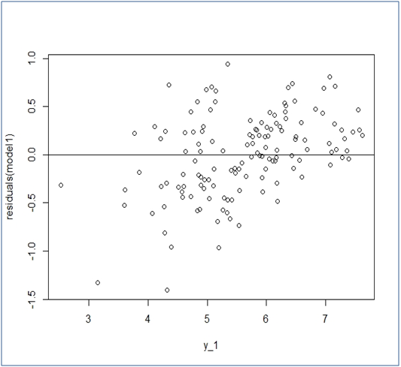
Using Ridge Regression Model
A) Residual Plot vs fitted y
It shows a slight U shaped pattern.

Slide 29
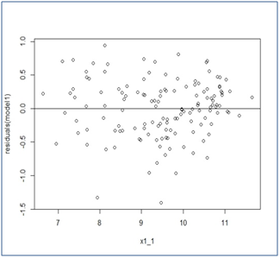
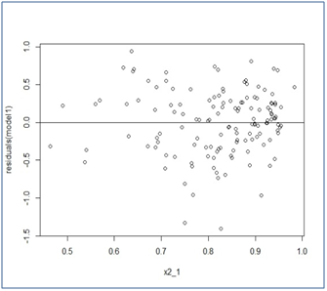
Residual plots vs. each of the predictors
Residual plot vs X1
Residual plot vs X2

Slide 30
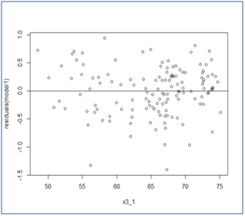
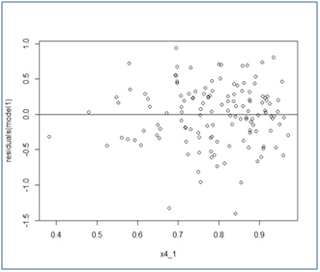
Residual plot vs X3
Residual plot vs X4

Slide 31
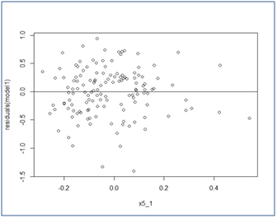
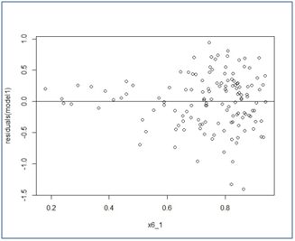
Residual plot vs X5
Residual plot vs X6
The plots vs x₄,x₅ & x₆ show some unusual pattern which needs to be checked further.

Slide 32
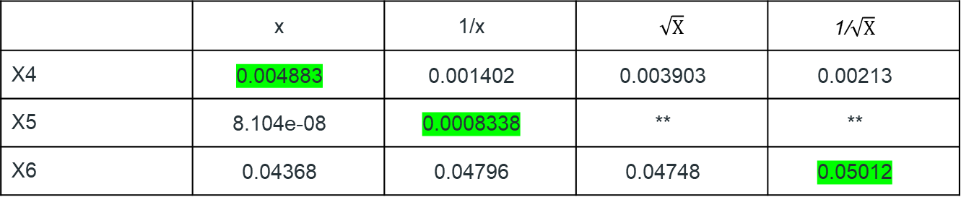
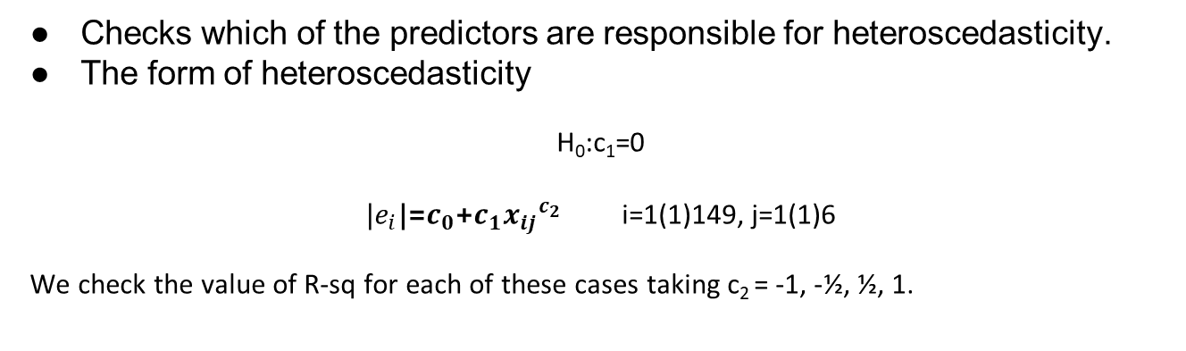
Glejser’s test
Checks which of the predictors are responsible for heteroscedasticity.
The form of heteroscedasticity
H₀:c₁=0
|$e_{i}$|=$c_{0}$+$c_{1}{x_{ij}}^{c_{2}}$ i=1(1)149, j=1(1)6
We check the value of R-sq for each of these cases taking c₂ = -1, - ½, ½, 1.
 | x | 1/x | $$\sqrt{X}$$ | 1/$\sqrt{X}$
X4 | 0.004883 | 0.001402 | 0.003903 | 0.00213
X5 | 8.104e-08 | 0.0008338 | ** | **
X6 | 0.04368 | 0.04796 | 0.04748 | 0.05012
(**) x₅ takes some negative values, so square root of x₅ is not defined

Slide 33
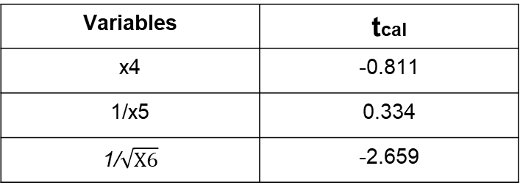
Variables | tcal
x4 | -0.811
1/x5 | 0.334
1/$\sqrt{X6}$ | -2.659
ttab(0.05,134) = 2.266
X4 and X5 are accepted at 5% level of significance.
X6 is rejected at 5% level of significance.
X4 and X5 are homoscedastic and we need further checks for X6.

Slide 34
Goldfeld-Quandt test
Perform this for X6.
P-value is 0.1265
Indicates heteroscedasticity is not significant .

Slide 35
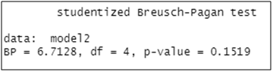
Breusch–Pagan test
Breusch–Pagan test (named after Trevor Breusch and Adrian Pagan) is used to test for heteroscedasticity in a linear regression model. It tests whether the estimated variance of the residuals from a regression are dependent on the values of the independent variables.
Ho: Residuals are homoscedastic
Against
H1: Ho is not true.
p-value is more than α = 0.05, we accept the null hypothesis that the data is homoscedastic.

Slide 36
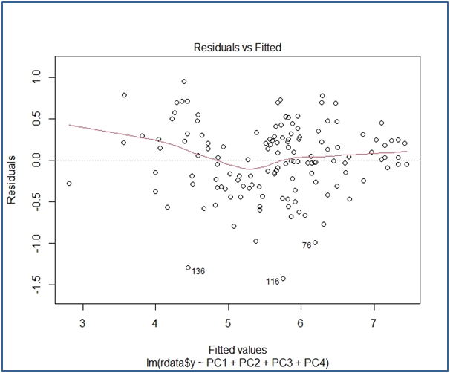
Using PCR Model
A) Residual Plot vs fitted y
There is a slight S shaped pattern in the plot. So, we’ve found out the residual plots vs. each of the predictors to check which of these are responsible for this pattern.

Slide 37
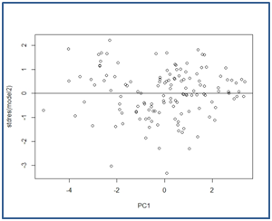
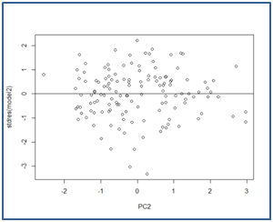
Residual plot vs PC1
Residual plot vs PC2

Slide 38
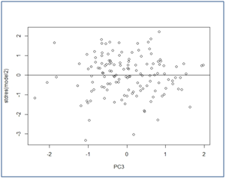
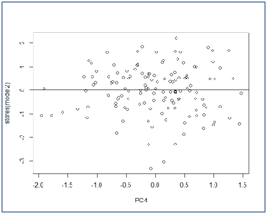
Residual plot vs PC3
Residual plot vs PC4
There is no significant pattern in these plots. So, we don’t go for any further tests.

Slide 39
Predictive Power
Using PRESS statistic, we compute R²_{pred}
For Ridge regression model,
R²_{pred} = 0.8086
For PCR model,
R²_{pred} =0.8110
So, the models can be reliably used for predicting happiness.

Slide 40
Ridge Regression vs PCR Model
Ridge Regression
A slight heteroscedasticity in residual plots
R²_{pred} = 0.8086
PCR
No significant pattern even in the residual plots
R²_{pred} = 0.8110
slightly better predictive power

Slide 41
Final Model and Summary

Slide 42
Model After Ridge Regression
Y = -1.5781 + 0.2390 x1 + 2.4325 x2 + 0.0298 x3 + 2.1707 x4 + 0.4991 x5 - 0.9676 x6
Summary:
Ridge minimum MSE = 2.44 at K=0.02976505
p-value for F-test (5,149) = 3.242863e-45 < 0.05
Regression model is significant .
R² | adj-R² | F
0.8085 | 0.8012 | 101.71921

Slide 43
Model After PCR
Y = 5.612941 + 0.509072 PC1 + 0.112711 PC2 - 0.057716 PC3 - 0.001522 PC4
Summary:
F(on 4 and 131 df)= 152.9
p-value = 2.2e-16 < 0.05
Regression Model Significant .
Multiple R² | Adj- R²
0.8236 | 0.8182

Slide 44
Plot of Predicted vs. Original Ladder Score

Slide 45
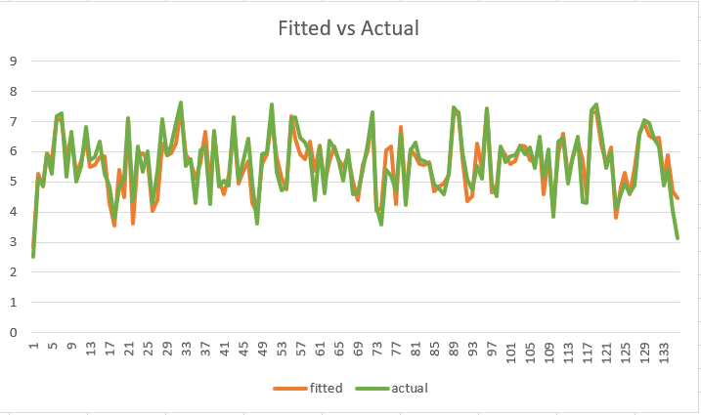
Ridge Regression Model

Slide 46

PCR Model

Slide 47
Conclusion
Ridge:
Adj R-sq = 80.12%
Predictive power = 80.86%
PCR:
Adj R-sq = 81.82%.
Predictive power = 81.10%

Slide 48
Thank You!!!

